Slide 1
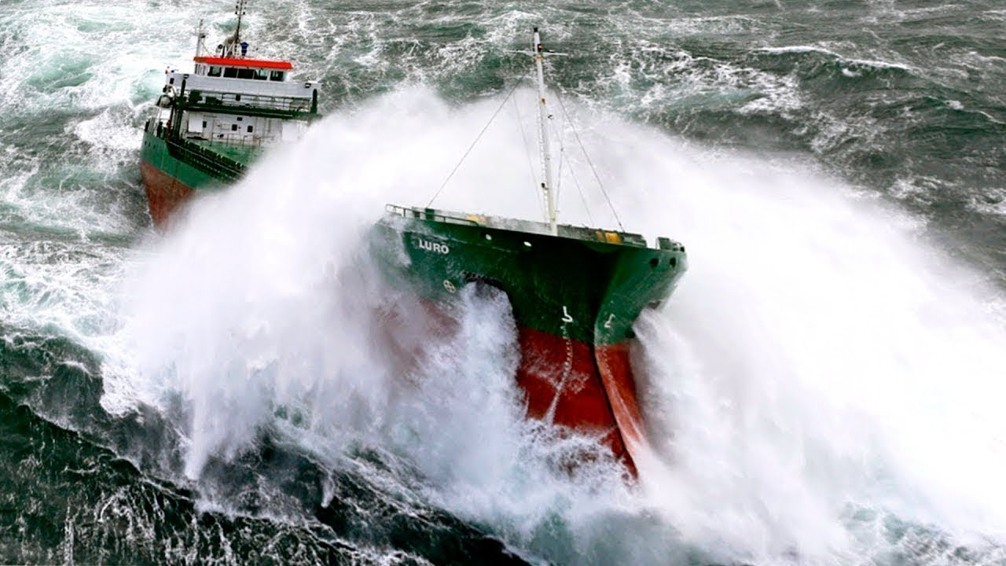
Anna Boon
2021-8-24
SHS Colloquium
Experimental investigation of green water lifetime loadings
(Woodford, K. 2010)

Slide 2
Content
The project
Research
Chosen subject
Research method
Summary
Discussion

Slide 3
Work Package A:
Top-down multi-fidelity design architectural framework
The project
Research
- Subject
- Method
Summary
Discussion
Input
Output
New Design Method
Work Package C:
Targeted inputs for high-order extreme wave loading models
Multi-fidelity probabilistic design framework
Improved designer insight into extreme wave loading and reliability of complex sea-going structures
Work Package B:
Work Package B:
Bottom-up development of reduced-order extreme wave loading models
Bottom-up development of reduced-order extreme wave loading models

Slide 4
Green water impact at bow
The project
Research
- Subject
- Method
Summary
Discussion
(Woodford, K. 2010)

Slide 5





Literature green water
The project
Research
- Subject
- Method
Summary
Discussion
Dambreak
Plunging
Relative over absolute wave height
White water
Dambreak - Plunging
Hammer - fist
Wave steepness

Slide 6
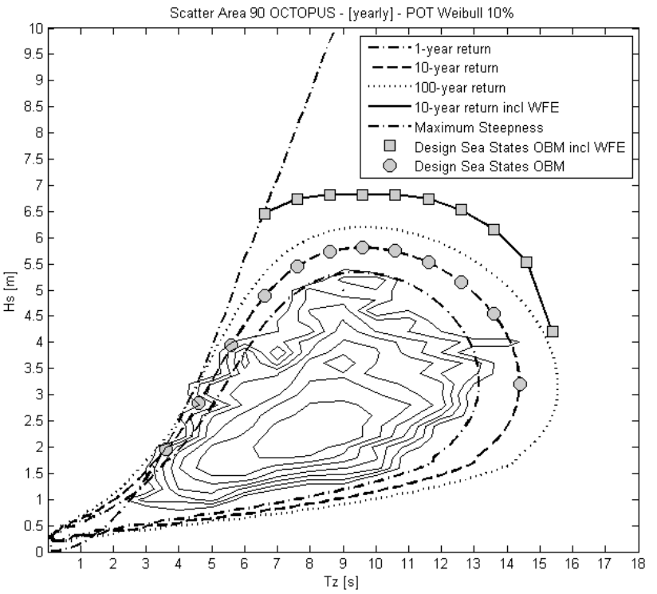
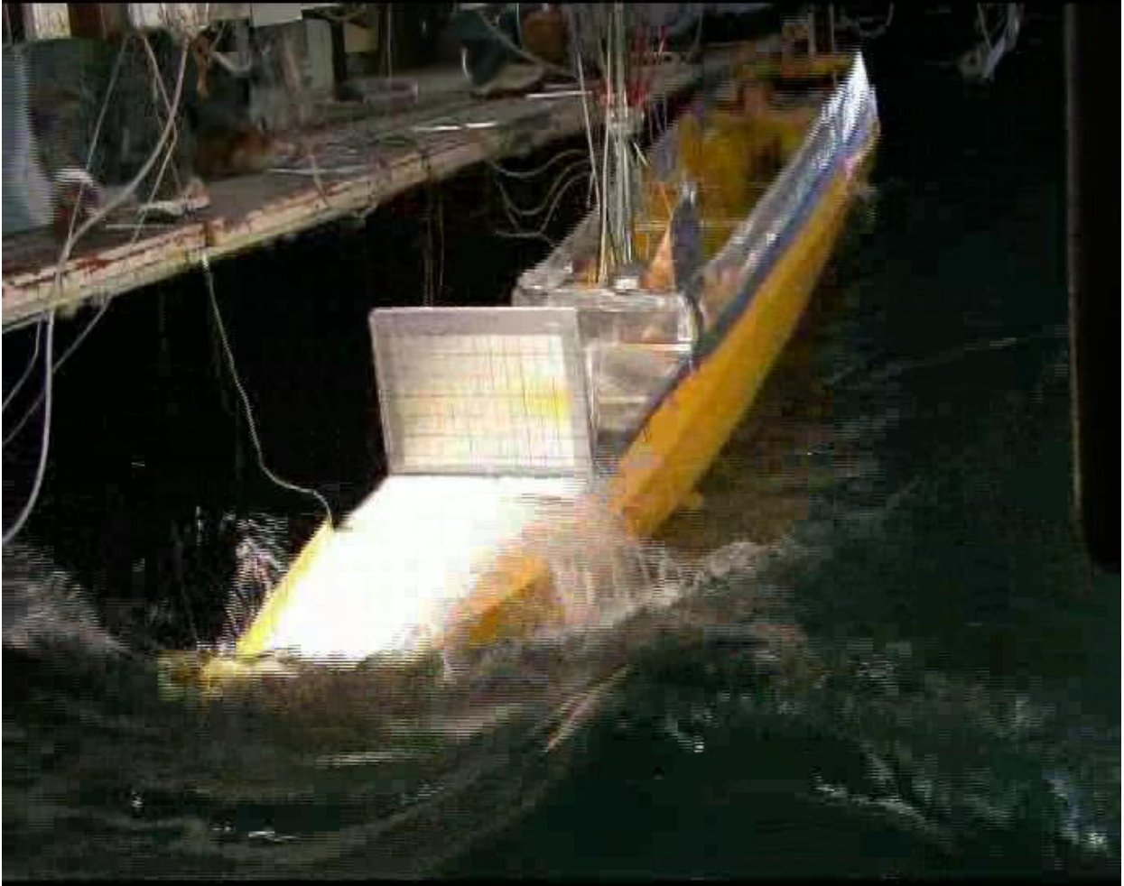
Research subjects
The project
Research
- Subject
- Method
Summary
Discussion
Lifetime loadings
&
Scaling effects
Hs [m]
Tz [s]
(Greco, 2013)
(Deelen, M. & de Jonge, J. 2014)

Slide 7
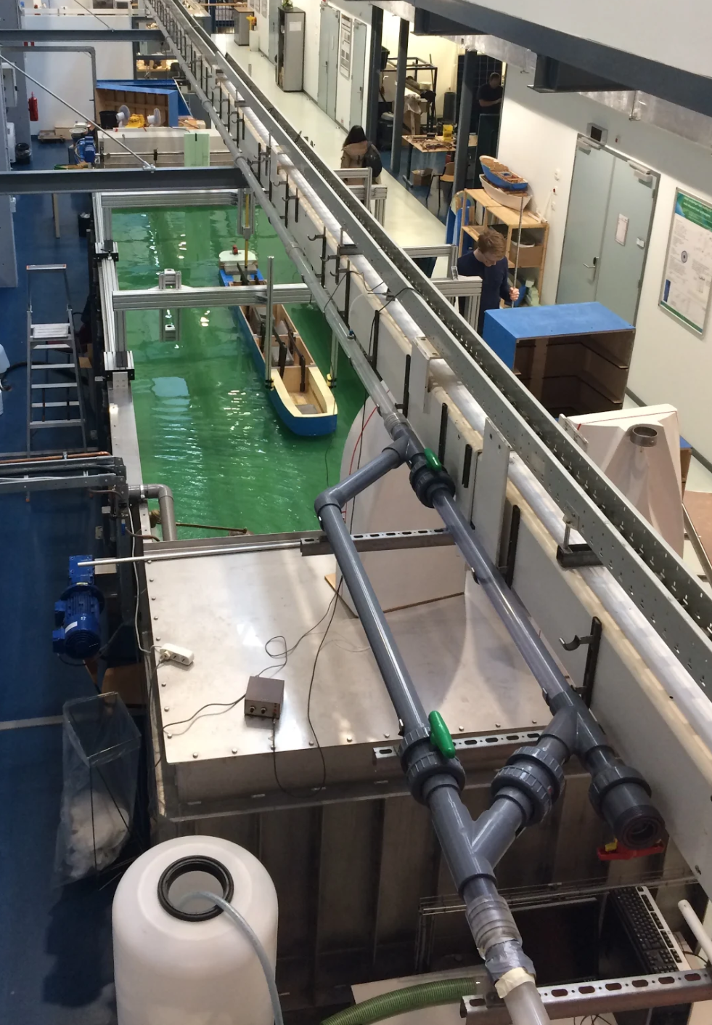
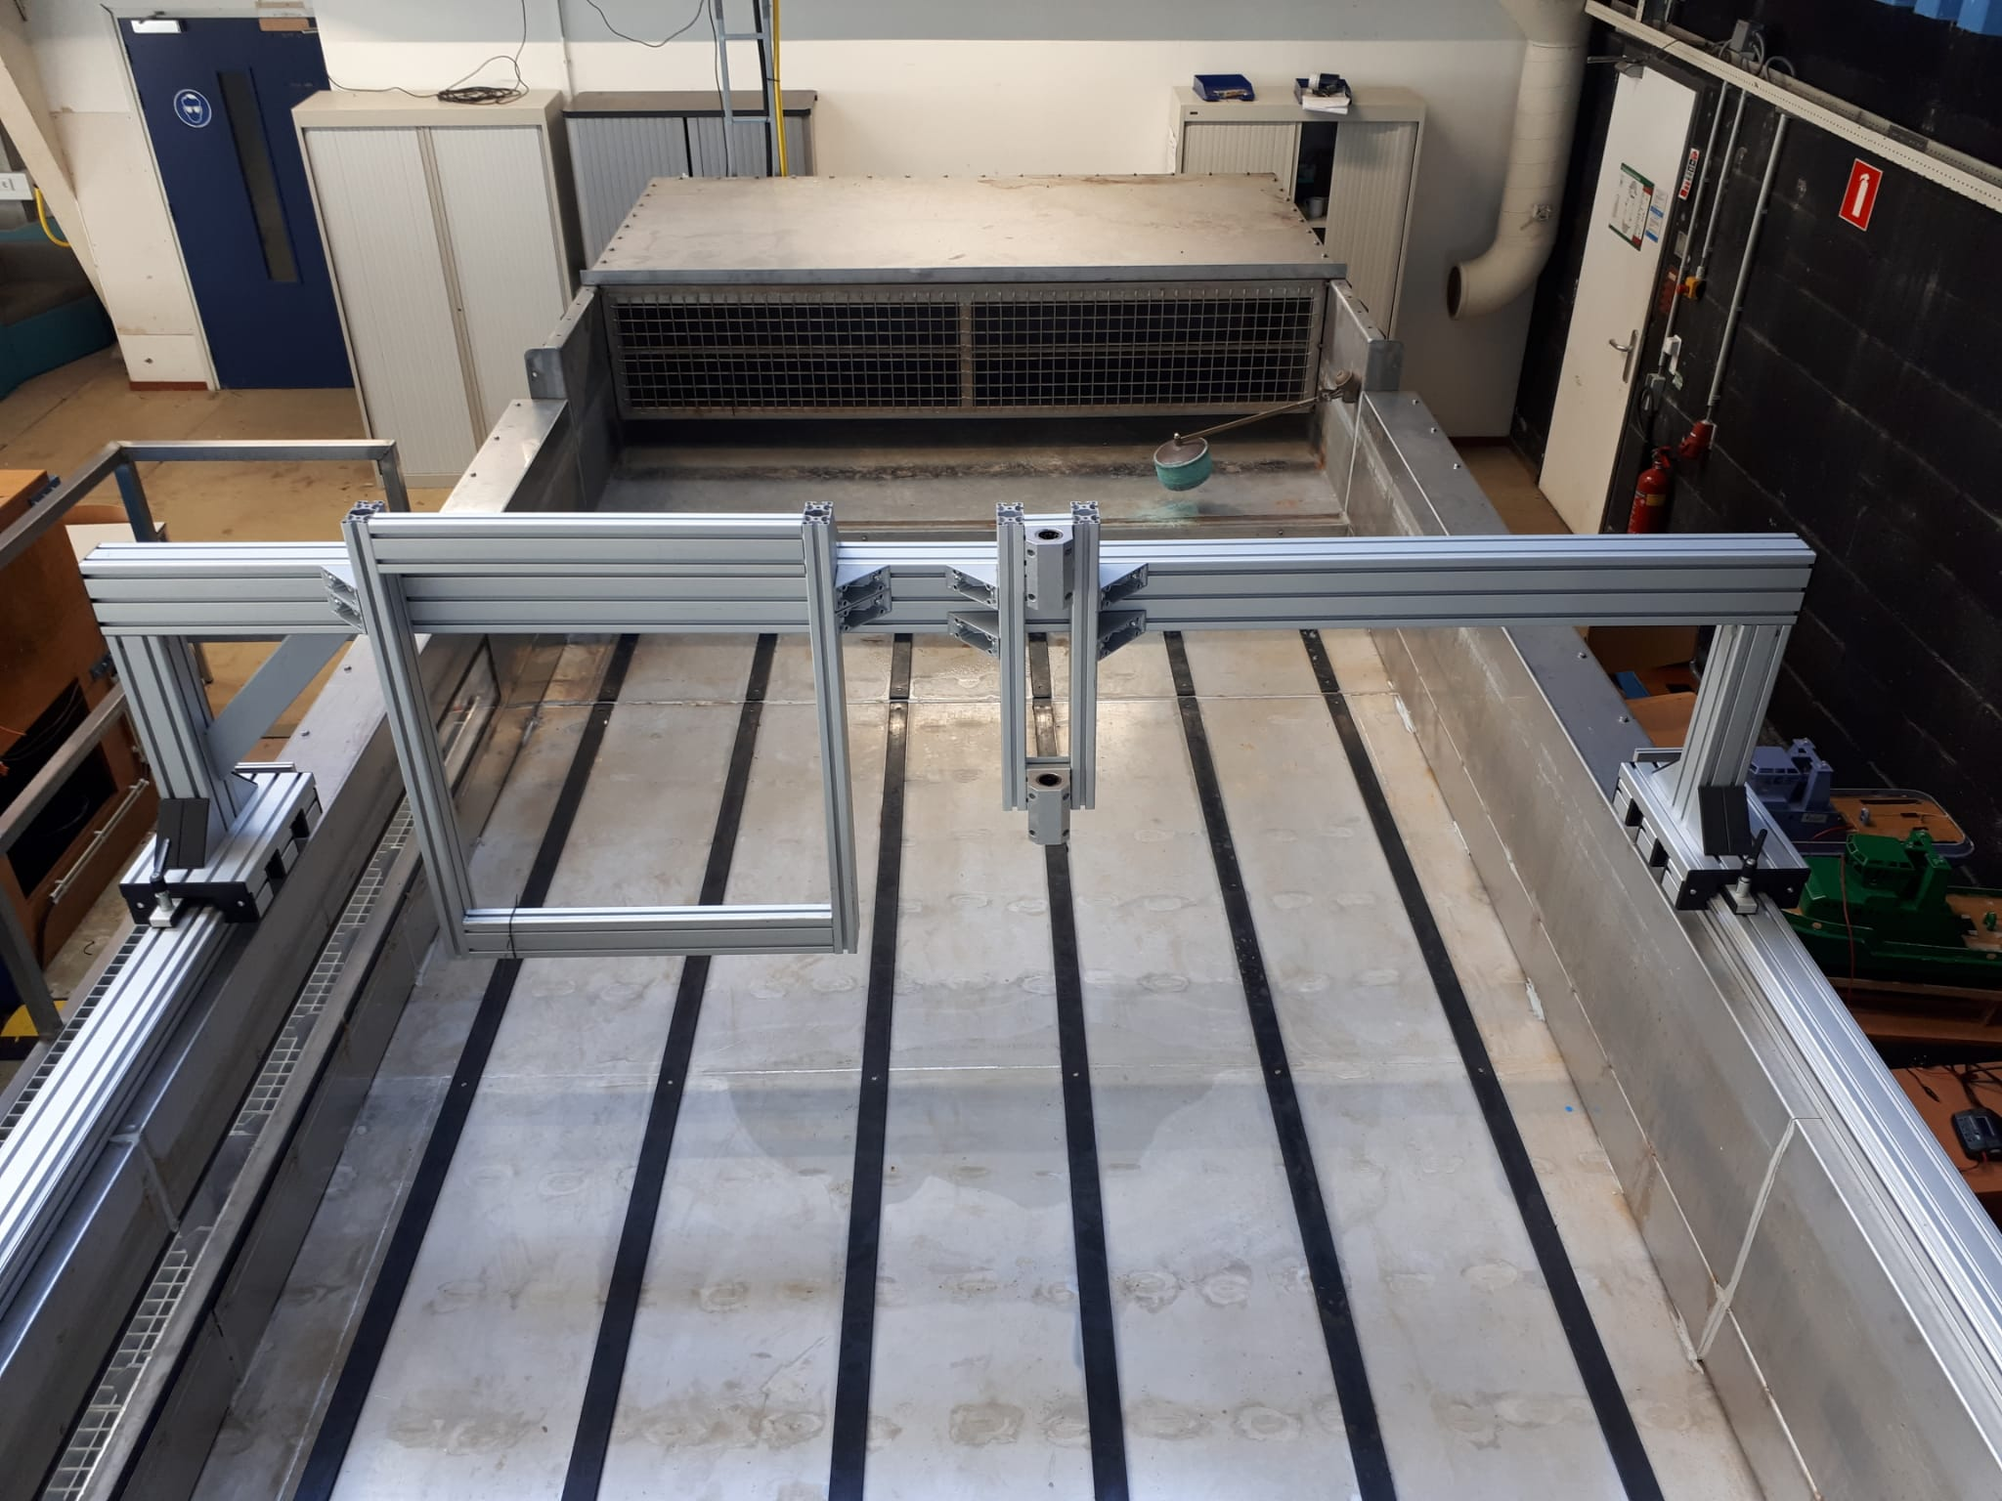
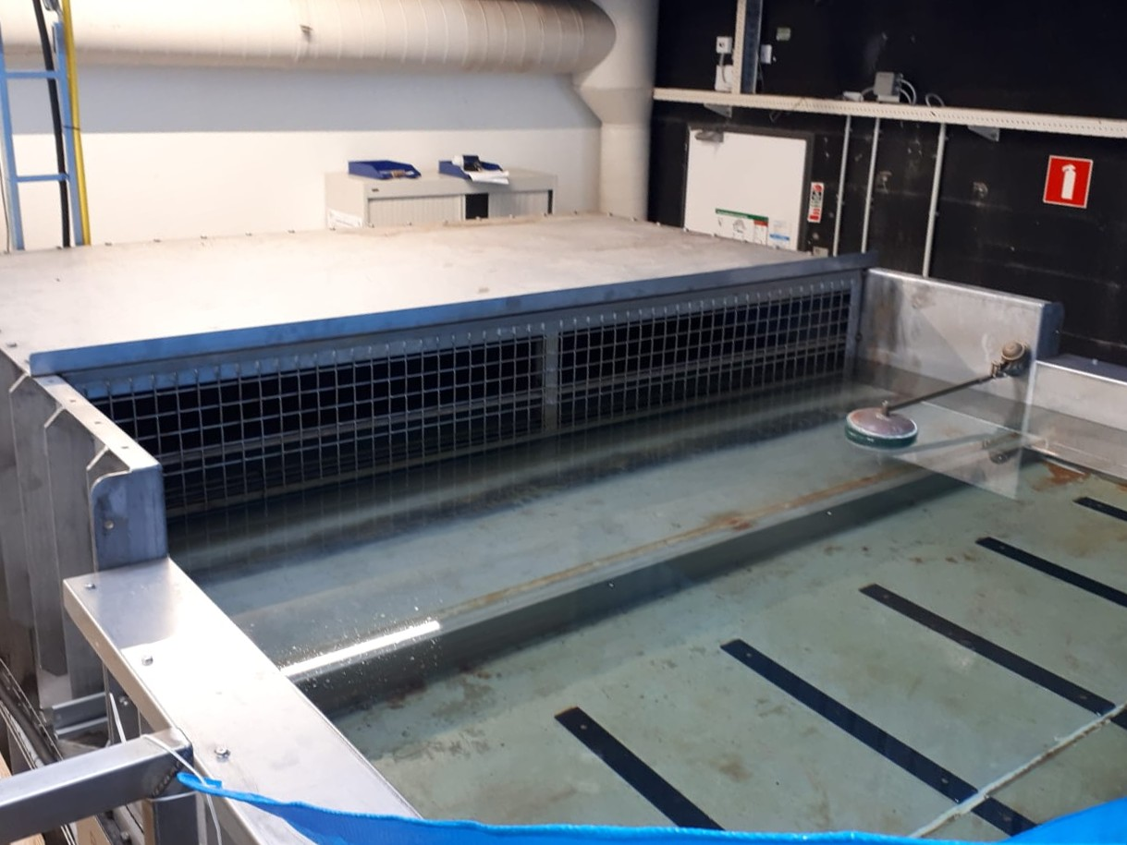
Lifetime loading experiments
The project
Research
- Subject
- Method
Summary
Discussion

Slide 8

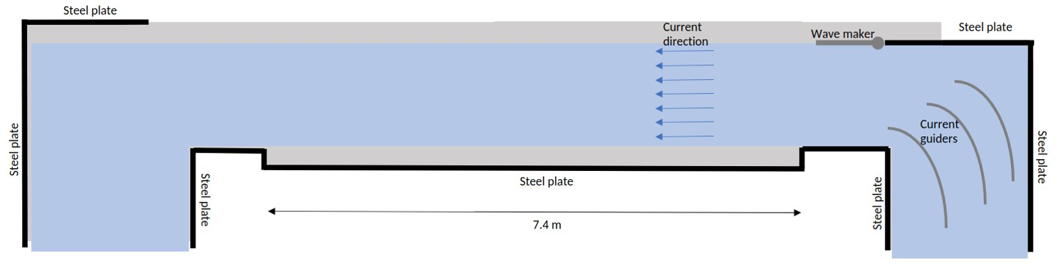
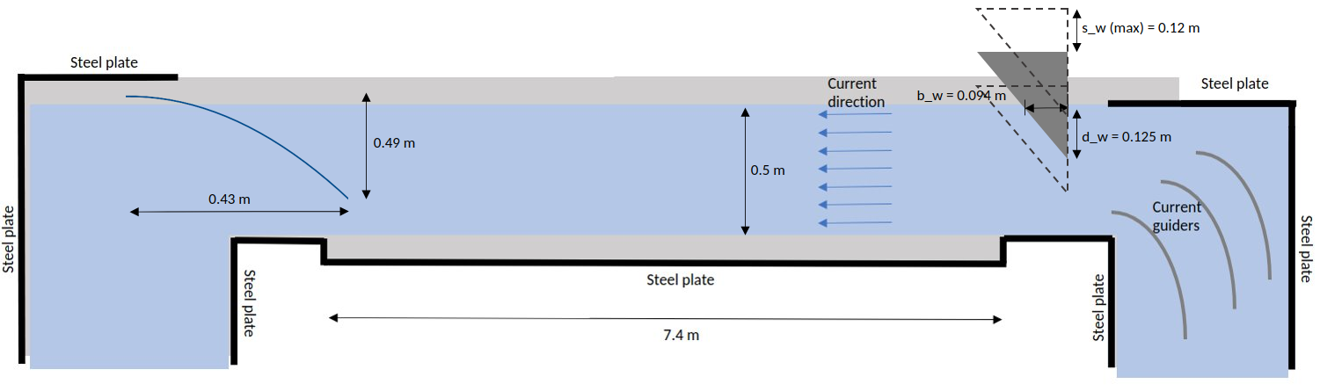
Adaptations flumetank
The project
Research
- Subject
- Method
Summary
Discussion

Slide 9
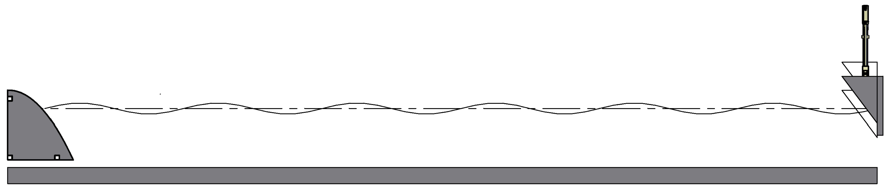
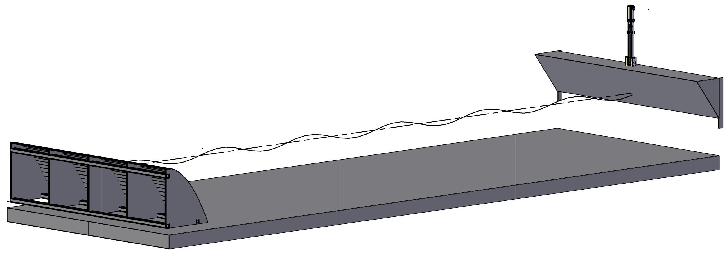
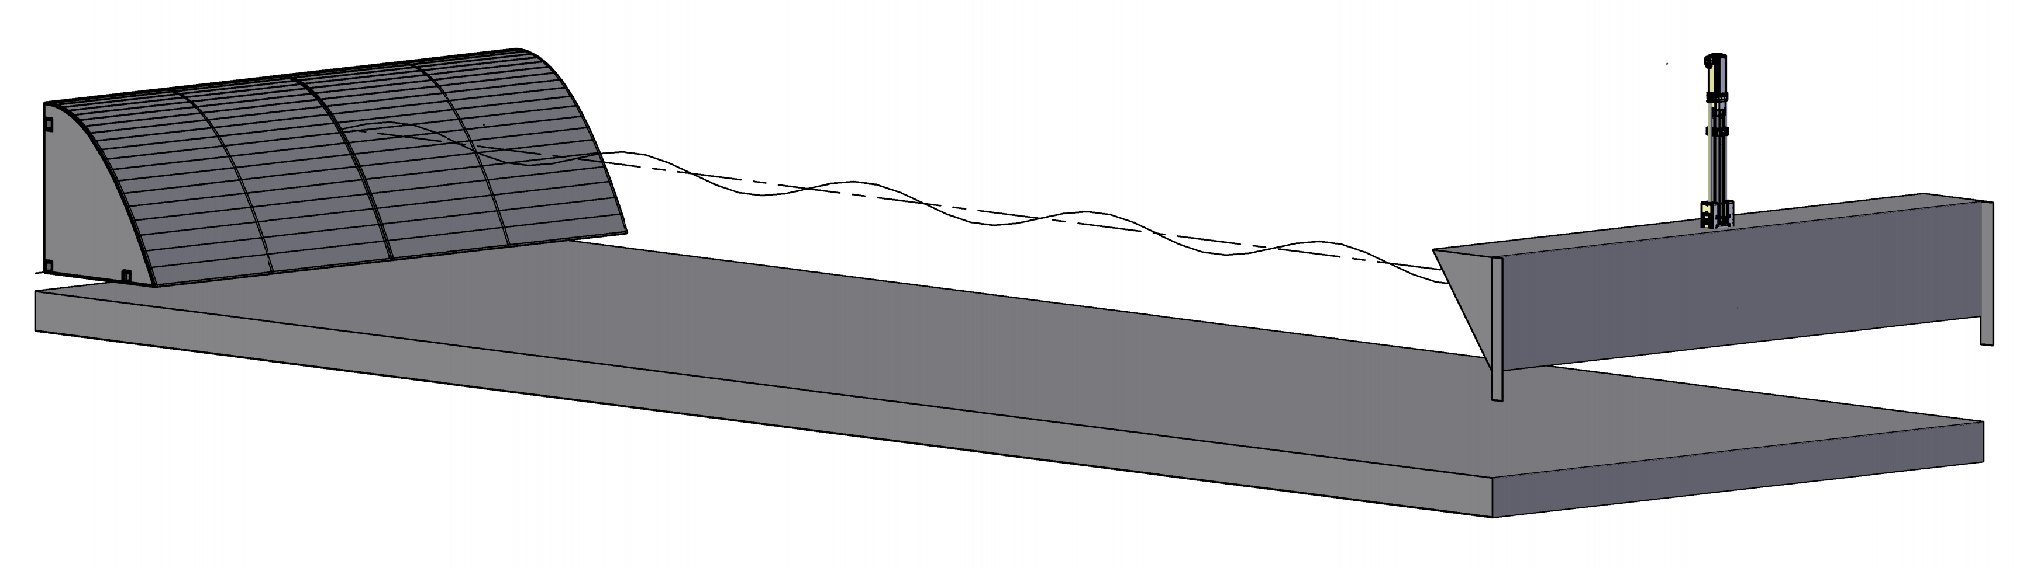
Adaptations: progress
The project
Research
- Subject
- Method
Summary
Discussion

Slide 10

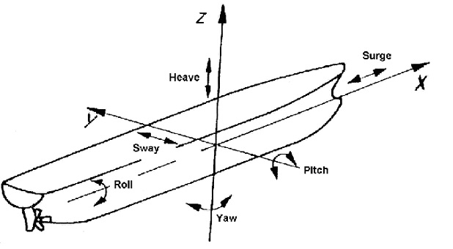
Lifetime loading test setup
The project
Research
- Subject
- Method
Summary
Discussion
Waves
Current
(Djebli et al., 2015)

Slide 11
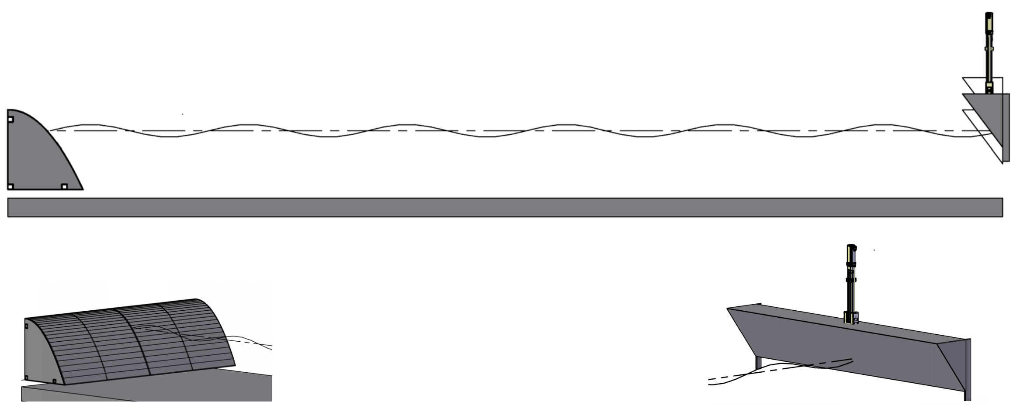

Summary
The project
Research
- Subject
- Method
Summary
Discussion

Slide 12




Discussion point
The project
Research
- Subject
- Method
Summary
Discussion
+

Slide 13
Questions?
The project
Research
- Subject
- Method
Summary
Discussion

Slide 14
References
Woodford, K. (2010, 27 May), The latest numbers say that Fonterra is struggling to turn around both its performance and its balance sheet, says Keith Woodford
Greco, M. (2013). Green Water on Ship Decks. Norway: Centre of Excellence for Ships and Ocean Structures
Deelen, M. & de Jonge, J. (2014). An Operational Based Method for Determining the Design Sea States of Heavy Transport Vessels. Marine Heavy Transport & Lift IV, 29-30 October
Djebli, A. M., Hamoudi, B., Imine, O. Adjlout, L. (2015). The application of smartphone in ship stability experiment. URL: https://images.app.goo.gl/puzCA7fsVW2qeUYs9
Dias, F. & Ghidaglia, J.-M. (2018). Slamming: Recent Progress in the Evaluation of Impact Pressures. Annual Reviews Fluid Mechanics, 243-73
TU Delft. (n.d.). Towing tank No. 2. Visited on 17 mei 2021, URL: https://www.tudelft.nl/3me/over/afdelingen/maritime-and-transport-technology/research/ship-hydromechanics/facilities/towing-tank-no-2
TU Delft. (n.d.). Towing tank No. 1. Visited on 17 mei 2021, URL: https://www.tudelft.nl/3me/over/afdelingen/maritime-and-transport-technology/research/ship-hydromechanics/facilities/towing-tank-no-1

Slide 15
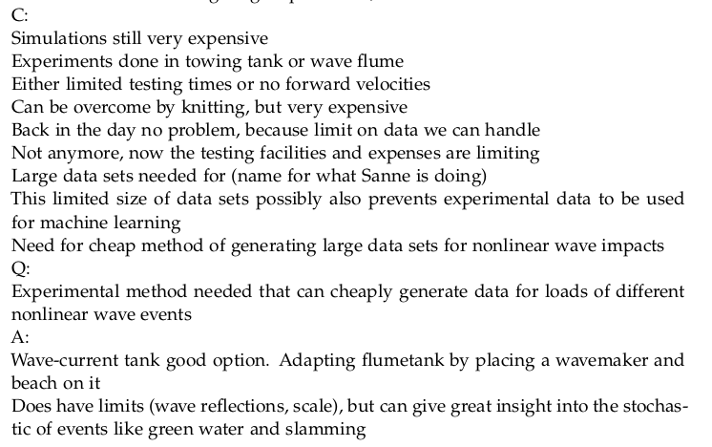
Another idea behind it
The project
Research
- Subject
- Method
Prospects
Summary

Slide 16
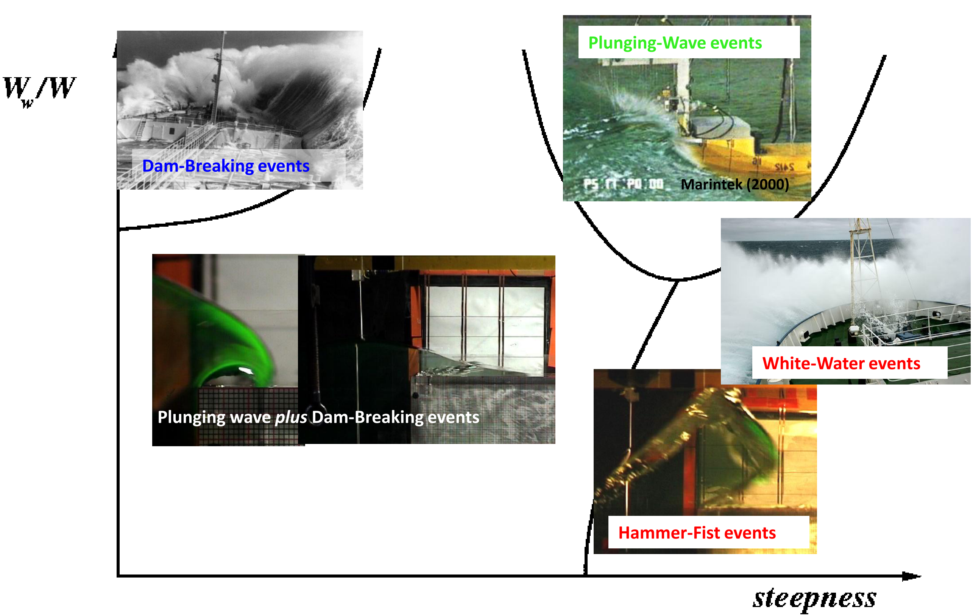
Literature green water
Recap WP B
Research
- Subject
- Method
Prospects
Summary
(Greco, 2013)

Slide 17



Future prospects
Case study
Lifetime loading Experimental accuracy
The project
Research
- Subject
- Method
Prospects
Summary
Discussion

Slide 18
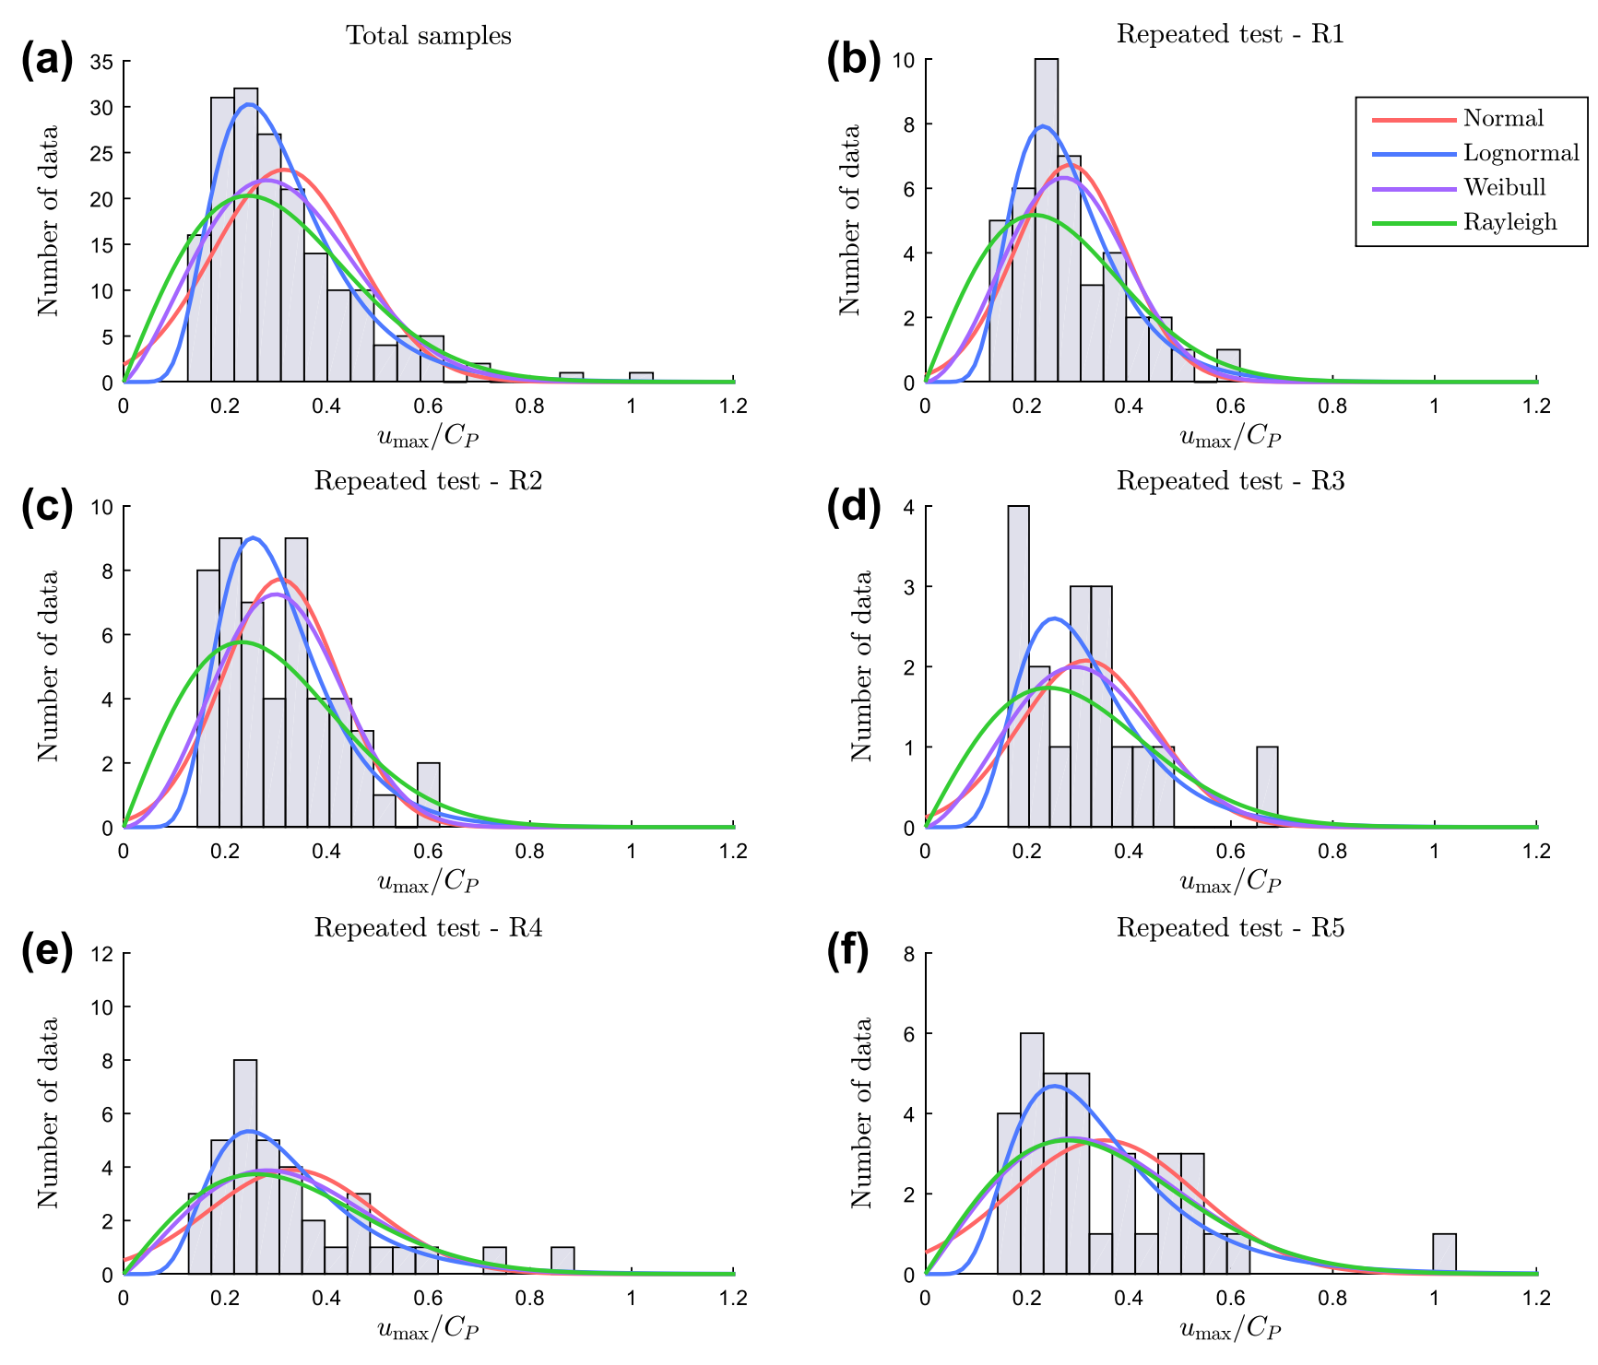
Knitting, 179 events
(Chuang et al. 2018)

Slide 19
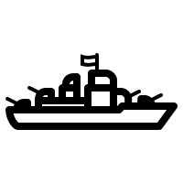






Slide 20


Slide 21

Research subjects
Recap WP B
Research
- Subject
- Method
Prospects
Summary
Lifetime loadings
Scaling effects
&
1 : 125

Slide 22
Research subjects
Recap WP B
Research
- Subject
- Method
Prospects
Summary
Lifetime loadings
&
Scaling effects
Hs [m]
Tz [s]
(Greco, 2013)
(Deelen, M. & de Jonge, J. 2014)

Slide 23
Experimental investigation of green water lifetime loadings
Anna Boon
2021-8-24

Slide 24
Experimental investigation of green water lifetime loadings
Anna Boon
2021-8-24

Slide 25
Discussion point
The project
Research
- Subject
- Method
Prospects
Summary
+

Slide 26
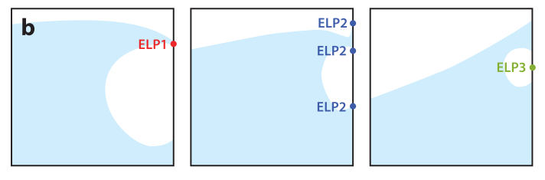
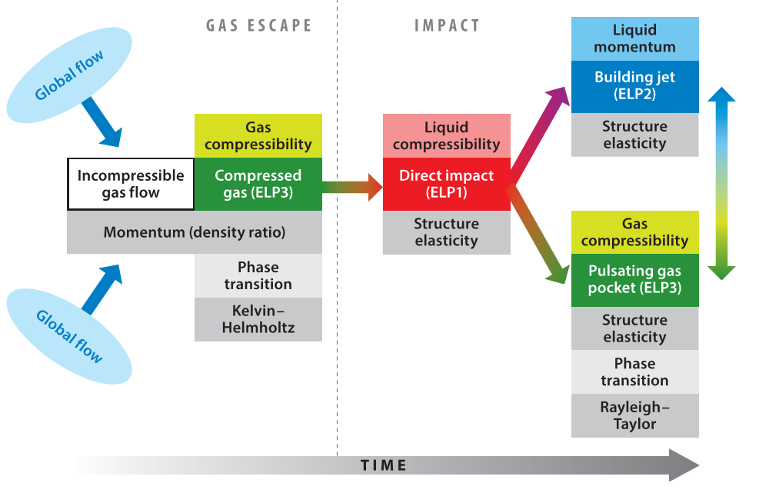
Scaling experiments
The project
Research
- Subject
- Method
Prospects
Summary
(Dias and Ghidaglia, 2018)

Slide 27
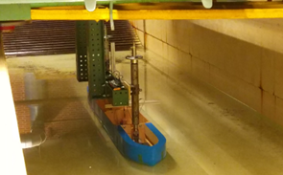
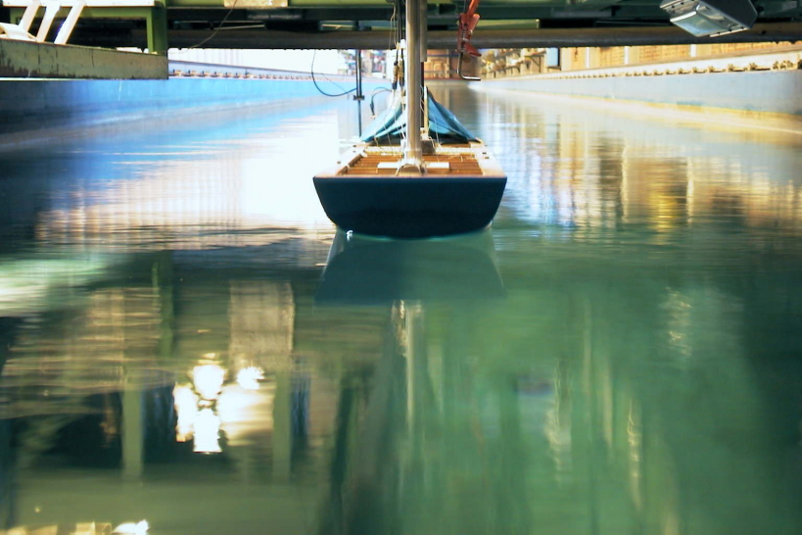
Scaling experiments
The project
Research
- Subject
- Method
Prospects
Summary
1:125
1:85
1:50
towing tank 1
towing tank 2
(TU Delft)
(TU Delft)

